Slide 1

EDUCATIONAL ASSESSMENT SYSTEM
By- Ambar Roy(12021002016011)-12
- Shubhajit Biswas(22022002016016)-66
CSE(AIML)- 3rd Year

Slide 2
Introduction:- Assessing student performance is a critical aspect of any educational institution. The traditional paper-based assessment systems are cumbersome and prone to errors. This project presents a DBMS for student assessment that provides a structured and efficient platform for managing and analyzing student data.

Slide 3
Objective:- - To create a robust and user-friendly system for student assessment. - To automate the recording and processing of student grades and assessment data. - To enable easy retrieval and analysis of student performance data. - To enhance data security and privacy through authentication and authorization mechanisms.

Slide 4
Overview of this system:- The process of evaluating a student's learning progress and accomplishments using digital tools and technologies. It can be applied to many different goals, including formative, summative, and diagnostic evaluations. Numerous formats are possible, including tests, assignments, surveys, and quizzes.

Slide 5
Importance:- Online educational assessments are crucial for evaluating students' knowledge and skills in a digital age, offering flexibility, accessibility, and scalability for both educators and learners. They enable data-driven insights, personalized feedback, and the ability to adapt teaching methods, ultimately enhancing the quality of education and ensuring students are better prepared for the demands of the modern world.

Slide 6
Data Collection and Analysis:- - Admins can add, modify, or delete student records, courses, and assessments. - Data input is validated to ensure data integrity and accuracy. - Database triggers and stored procedures are used for automating certain processes.

Slide 7
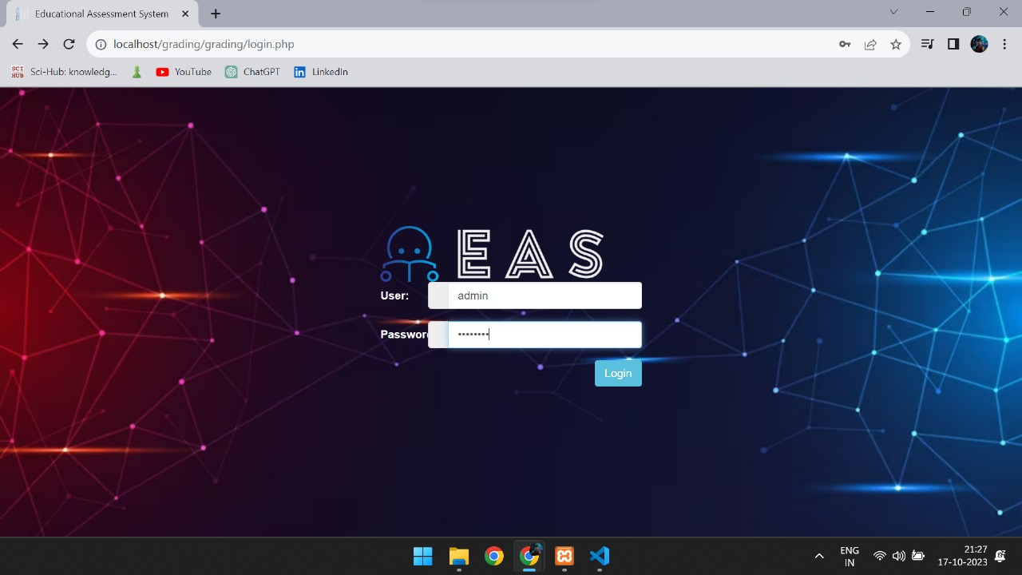
Login Page :-

Slide 8
Technology Used:- Software:- - Database Management System (DBMS): We have used MySQL in this project. - Scripting language for backend development: PHP, JavaScript. - Front-end development: HTML, CSS, JavaScript. Hardware:- - Server for hosting the database. - Client devices (computers or tablets) for data input and retrieval.

Slide 9
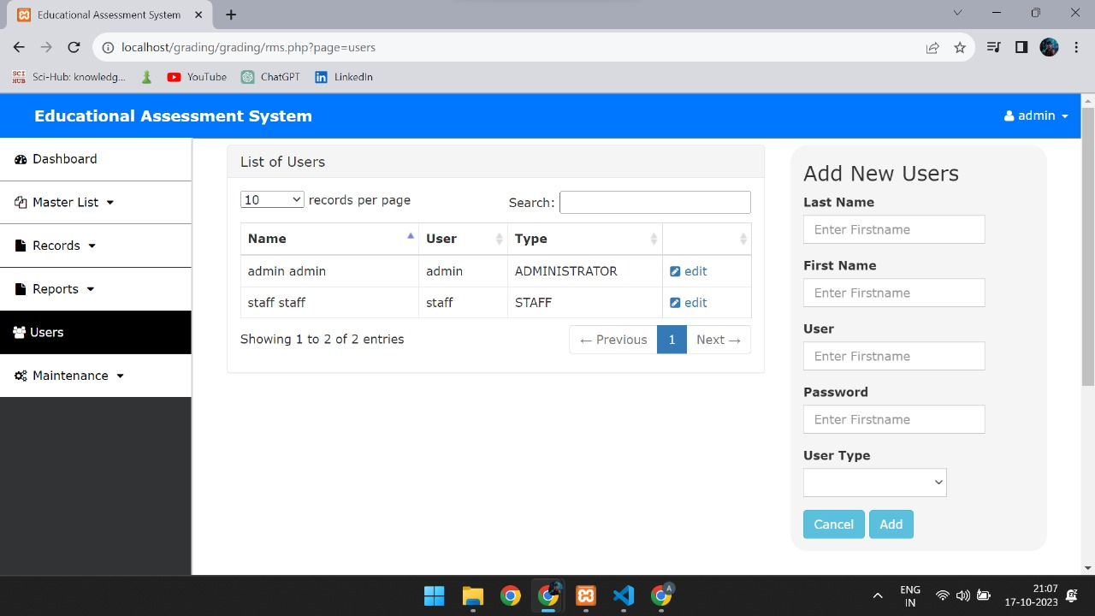

Slide 10
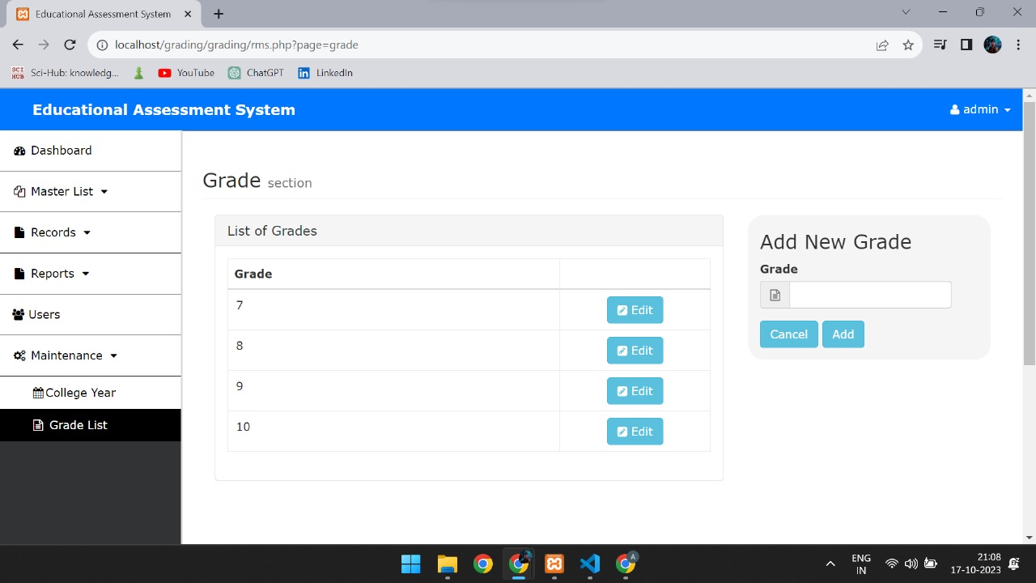

Slide 11
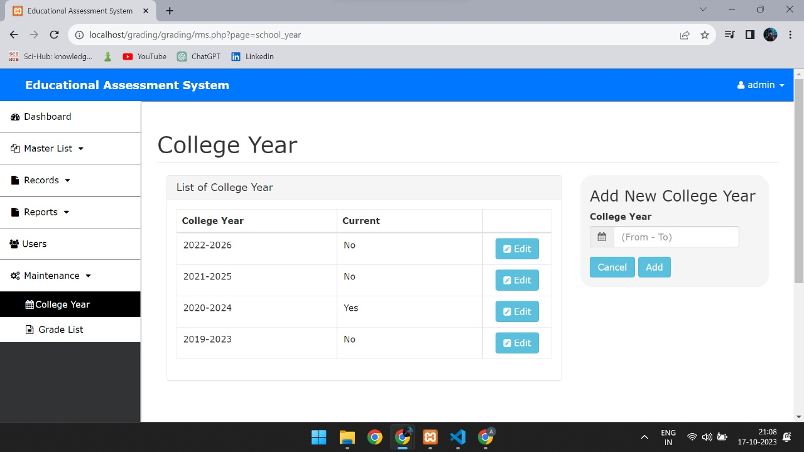

Slide 12
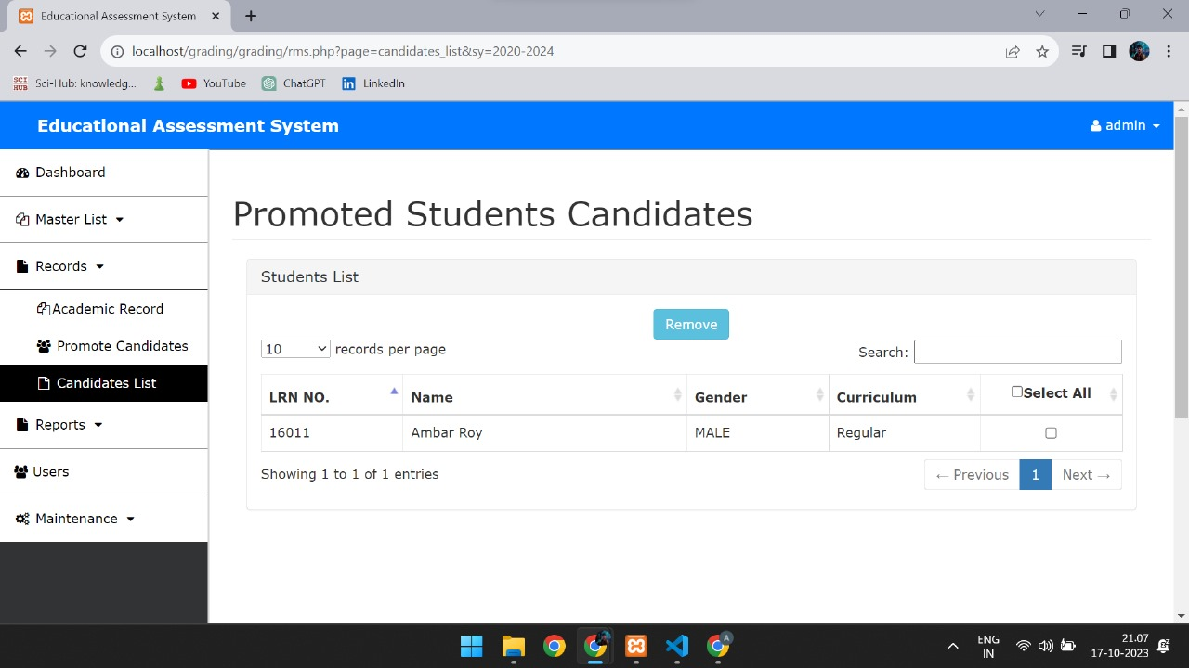

Slide 13
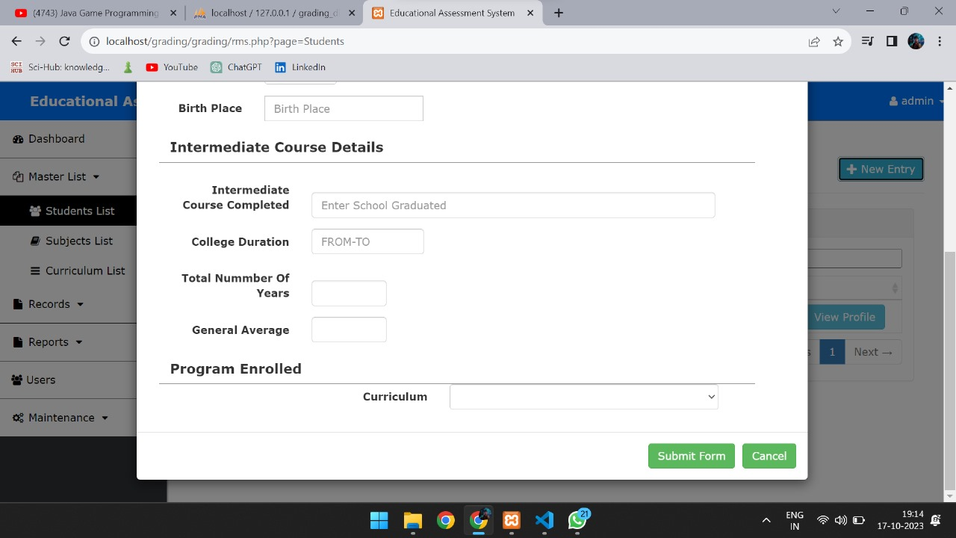

Slide 14
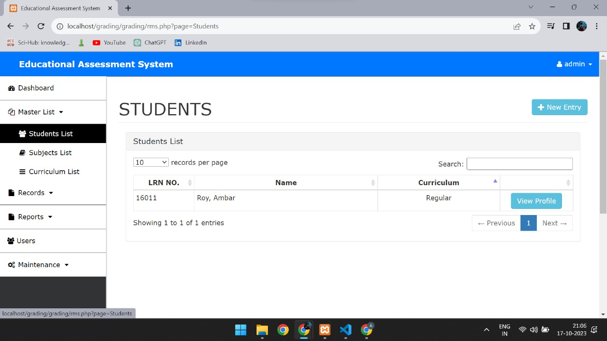

Slide 15
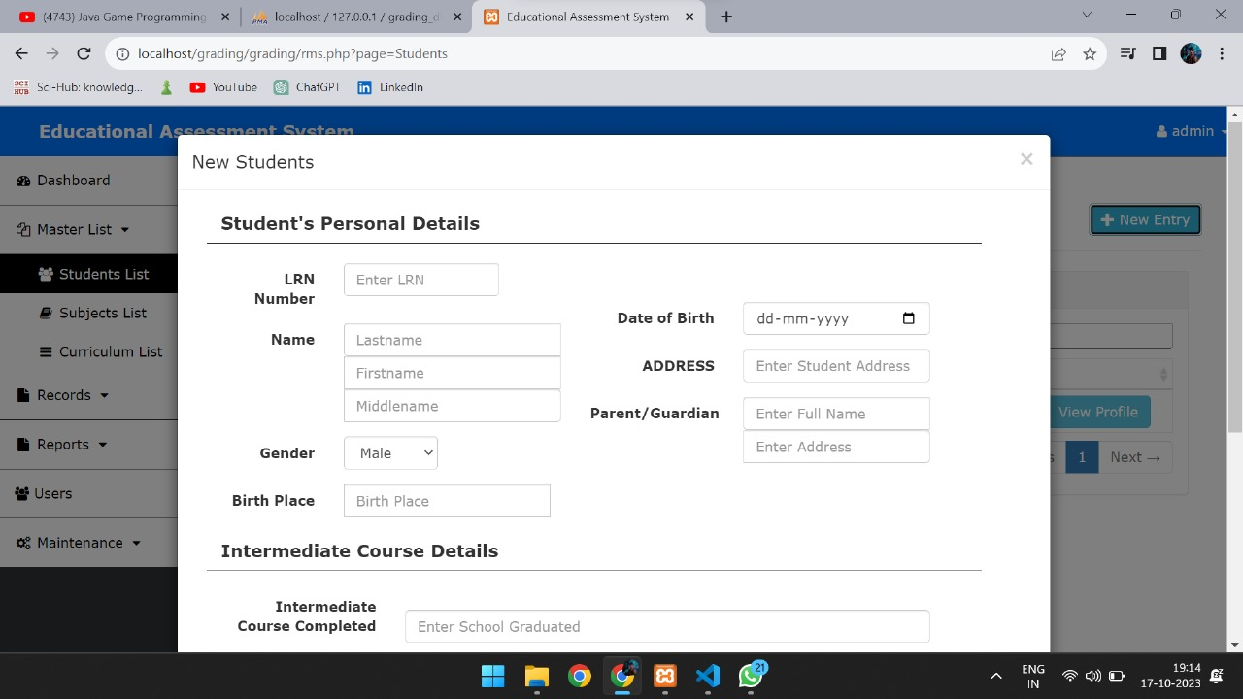

Slide 16
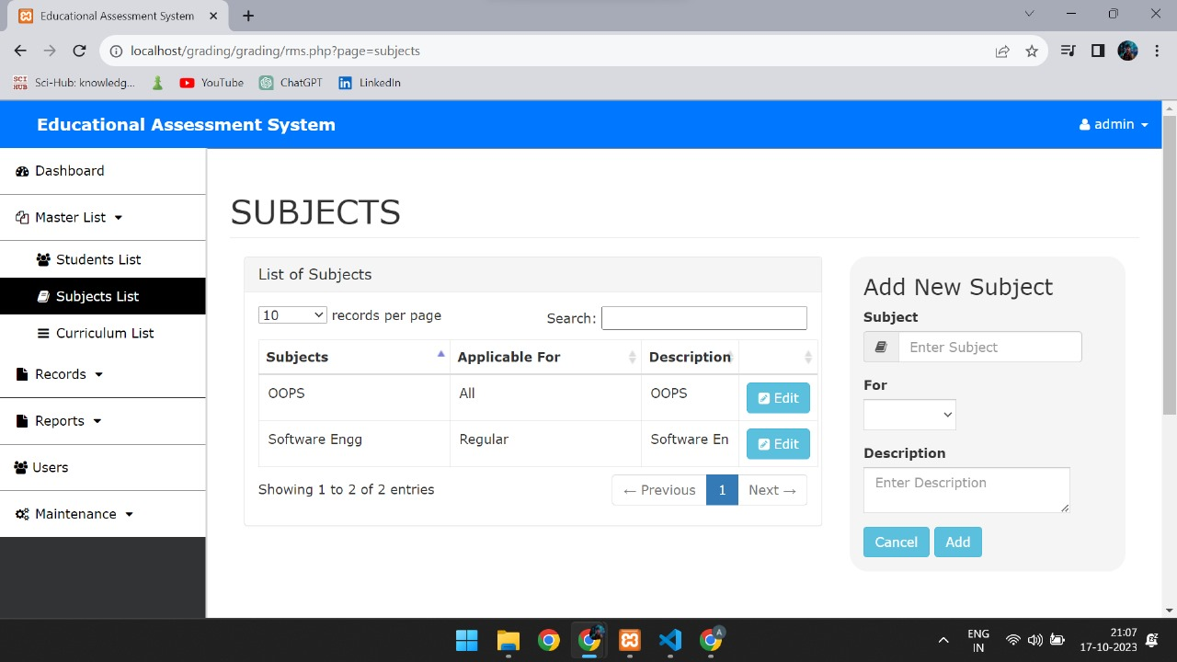

Slide 17
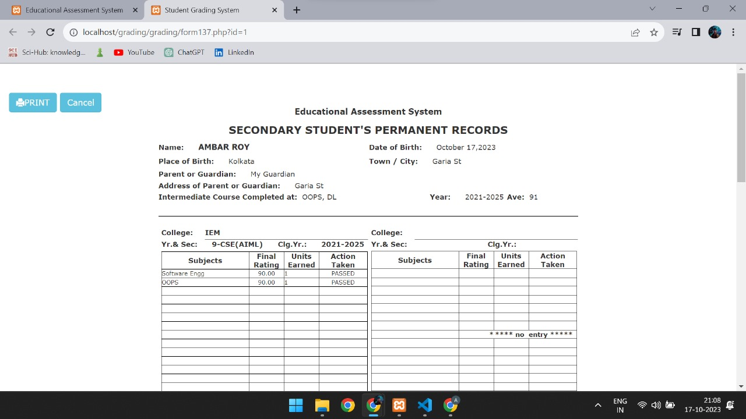

Slide 18
Conclusion:- The Student Assessment System in DBMS is a valuable tool for educational institutions to improve the assessment process. It simplifies data management, enhances security, and provides a user-friendly interface for users.

Slide 19
References:- - MySQL Documentation: https://dev.mysql.com/doc/ - HTML, CSS, JavaScript and PHP Resources: W3Schools (https://www.w3schools.com/), Bootstrap(https://getbootstrap.com/) - Youtube(https://www.youtube.com/)

